Slide 1
Coronavirus Disease 2019 (COVID-19)
There is currently no vaccine to prevent coronavirus disease 2019 (COVID-19).
The best way to prevent illness is to avoid being exposed to this virus.
The virus is thought to spread mainly from person-to-person. Between people who are in close contact with one another (within about 6 feet). Through respiratory droplets produced when an infected person coughs or sneezes.
These droplets can land in the mouths or noses of people who are nearby or possibly be inhaled into the lungs.

Slide 2

Take steps to protect yourself
Wash your hands often with soap and water for at least 20 seconds especially after you have been in a public place, or after blowing your nose, coughing, or sneezing.
If soap and water are not readily available, use a hand sanitizer that contains at least 60% alcohol. Cover all surfaces of your hands and rub them together until they feel dry.
Avoid touching your eyes, nose, and mouth with unwashed hands.

Slide 3

Avoid close contact
Avoid close contact with people who are sick
Put distance between yourself and other people if COVID-19 is spreading in your community. This is especially important for people who are at higher risk of getting very sick.

Slide 4

Stay home if you’re sick
Stay home except to get medical care
Stay home: People who are mildly ill with COVID-19 are able to recover at home. Do not leave, except to get medical care. Do not visit public areas.
Stay in touch with your doctor. Call before you get medical care. Be sure to get care if you feel worse or you think it is an emergency.
Avoid public transportation: Avoid using public transportation, ride-sharing, or taxis.

Slide 5
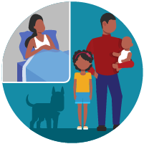
Separate yourself from other people in your home, this is known as home isolation
Stay away from others: As much as possible, you should stay in a specific “sick room” and away from other people in your home. Use a separate bathroom, if available.
Limit contact with pets & animals: You should restrict contact with pets and other animals, just like you would around other people.
Although there have not been reports of pets or other animals becoming sick with COVID-19, it is still recommended that people with the virus limit contact with animals until more information is known.

Slide 6
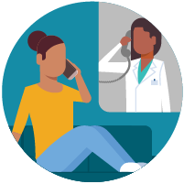
Call ahead before visiting your doctor
Call ahead: If you have a medical appointment, call your doctor’s office or emergency department, and tell them you have or may have COVID-19. This will help the office protect themselves and other patients.

Slide 7

Wear a facemask if you are sick
If you are sick: You should wear a facemask when you are around other people and before you enter a healthcare provider’s office.
If you are caring for others: If the person who is sick is not able to wear a facemask (for example, because it causes trouble breathing), then people who live in the home should stay in a different room. When caregivers enter the room of the sick person, they should wear a facemask.
Visitors, other than caregivers, are not recommended.

Slide 8
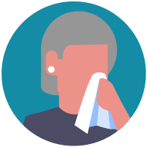
Cover your coughs and sneezes
Cover: Cover your mouth and nose with a tissue when you cough or sneeze.
Dispose: Throw used tissues in a lined trash can.
Wash hands: Immediately wash your hands with soap and water for at least 20 seconds. If soap and water are not available, clean your hands with an alcohol-based hand sanitizer that contains at least 60% alcohol.

Slide 9
Clean your hands often
Wash hands: Wash your hands often with soap and water for at least 20 seconds. This is especially important after blowing your nose, coughing, or sneezing; going to the bathroom; and before eating or preparing food.
Hand sanitizer: If soap and water are not available, use an alcohol-based hand sanitizer with at least 60% alcohol, covering all surfaces of your hands and rubbing them together until they feel dry.
Soap and water: Soap and water are the best option, especially if hands are visibly dirty.
Avoid touching: Avoid touching your eyes, nose, and mouth with unwashed hands.

Slide 10
Follow Five Steps to Wash Your Hands the Right Way
Wet your hands with clean, running water (warm or cold), turn off the tap, and apply soap.
Lather your hands by rubbing them together with the soap. Lather the backs of your hands, between your fingers, and under your nails.
Scrub your hands for at least 20 seconds. Need a timer? Hum the “Happy Birthday” song from beginning to end twice.
Rinse your hands well under clean, running water.
Dry your hands using a clean towel or air dry them.

Slide 11
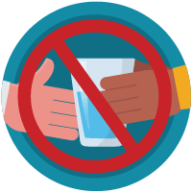
Avoid sharing personal household items
Do not share: Do not share dishes, drinking glasses, cups, eating utensils, towels, or bedding with other people in your home.
Wash thoroughly after use: After using these items, wash them thoroughly with soap and water or put in the dishwasher.

Slide 12

Clean all “high-touch” surfaces everyday
Clean high-touch surfaces in your isolation area (“sick room” and bathroom) every day; let a caregiver clean and disinfect high-touch surfaces in other areas of the home.
Clean and disinfect: Routinely clean high-touch surfaces in your “sick room” and bathroom. Let someone else clean and disinfect surfaces in common areas, but not your bedroom and bathroom.
If a caregiver or other person needs to clean and disinfect a sick person’s bedroom or bathroom, they should do so on an as-needed basis. The caregiver/other person should wear a mask and wait as long as possible after the sick person has used the bathroom.

Slide 13
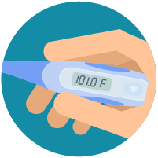
Monitor your symptoms
Seek medical attention, but call first: Seek medical care right away if your illness is worsening (for example, if you have difficulty breathing). Call your doctor before going in: Before going to the doctor’s office or emergency room, call ahead and tell them your symptoms. They will tell you what to do.
Wear a facemask: If possible, put on a facemask before you enter the building. If you can’t put on a facemask, try to keep a safe distance from other people (at least 6 feet away). This will help protect the people in the office or waiting room.
Facemask may not be available!

Slide 14

People with COVID-19 who have stayed home (home isolated) can stop home isolation under the following conditions:
If you will not have a test to determine if you are still contagious, you can leave home after these three things have happened:
    You have had no fever for at least 72 hours (that is three full days of no fever without the use medicine that reduces fevers)
    AND
    other symptoms have improved (for example, when your cough or shortness of breath have improved)
    AND
    at least 7 days have passed since your symptoms first appeared

Slide 15


Coronavirus Disease 2019 (COVID-19)
Thank you & Be Safe
Rick Hunter SafetyInfo.com

